Slide 1

SOEN 6441 ADVANCED PROGRAMMING PRACTICES
PROJECT: WARZONE
TEAM 15
GAURANG DOBARIYA-40184707
JAYNIL SAVANI-40156070
MANTHAN MORADIYA-40156072
VICKY PATEL-40185238
YASH VAGHANI-40155884
SUBMITTED TO: JOEY PAQUET

Slide 2
Introduction
In this project, we are developing Warzone. The Warzone is developed using Extreme Programming approach by following its features such as collective ownership, pair programming, continuous integration and testing . Here, we are specifically following incremental development model and releasing build with small number of features in each iteration. Furthermore, this game is developed using MVC(Model, View, Controller) architecture.

Slide 3
Objectives
Map Editor
User Driven creation or deletion of map elements (country, continent and connectivity between countries)
Create a new map
Edit an existing map
Show map
Validate map
Game Play
Start up Phase
Create and Add player
Assign countries to player
Main Game Loop
Assign Reinforcements
Issue Orders
Execute Orders

Slide 4
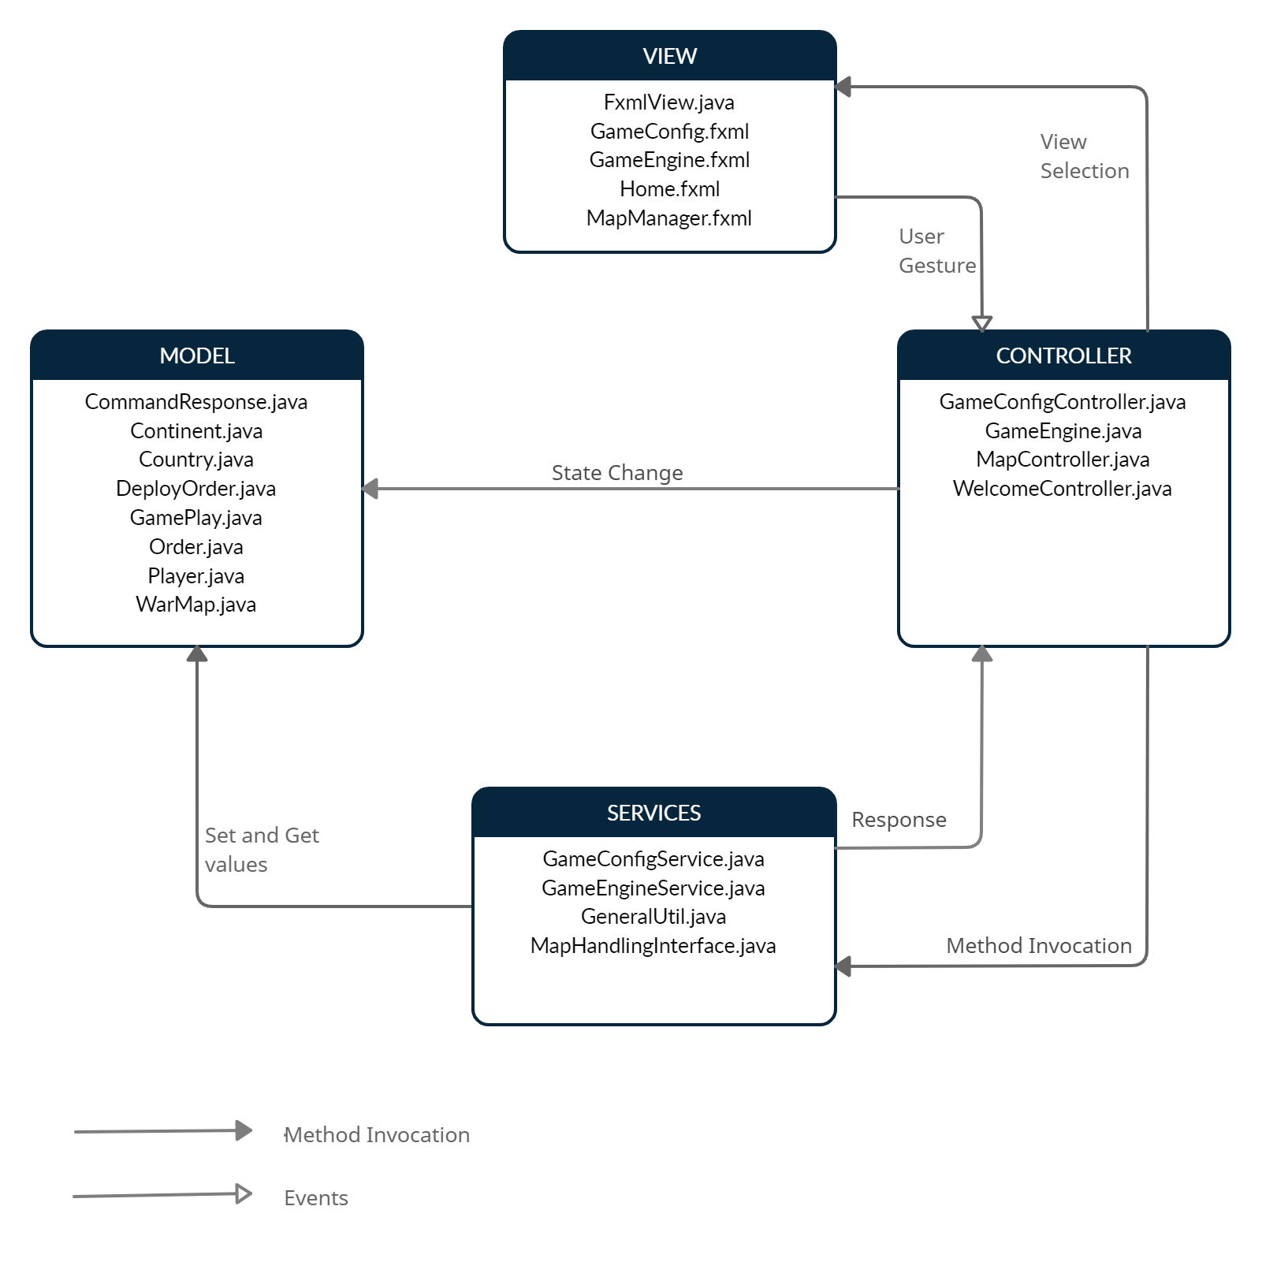
MVC Architecture Design

Slide 5
MODEL
File | Description
CommandResponse.java | This class represents structure of response of all the commands.
Continent.java | This class represents continent in the map, and it has a list of countries as well as control value.
Country.java | This class represents country of the map file. It's also having list of neighbor countries.
DeployOrder.java | This class is used for the deploy order command.
GamePlay.java | This class is used for manipulating game play information.
Order.java | This is the common interface for all order commands.
Player.java | This class is used for storing and manipulating player Information.
WarMap.java | WarMap class is the main model for map management. From here the data structure started. This Map is having Map of continents and continent will have countries and those countries will have their adjacent countries.

Slide 6
VIEW
File | Description
FxmlView.java | This class provides views of Application.
GameConfig.fxml | This file represents View which is responsible for Game Start up phase.
GameEngine.fxml | This file represents View which is responsible for playing game.
Home.fxml | This file represents Main Screen of the game.
MapManager.fxml | This file represents View which represents map related activities.

Slide 7
CONTROLLER
File | Description
GameConfigController.java | This class provides game configuration functionalities such as load map, create player and assign countries to player before the start game phase.
GameEngine.java | This class provides functionalities such as deploy armies, issue orders and execute orders in round robin fashion.
MapController.java | This class provides map management functionalities such as add an existing map, create a new map.
WelcomeController.java | This class represent main screen of game from which user can navigate to various phases of game.

Slide 8
SERVICES
File | Description
GameConfigService.java | This interface is used for all game related Configuration for game play.
GameEngineService.java | This interface is used to provide function for game playing.
GenerateUtil.java | This interface is used for Utility of General Functions.
MapHandlingInterface.java | This interface is used for Utility of Map Editor related commands.

Slide 9
Thank You

